Slide 1
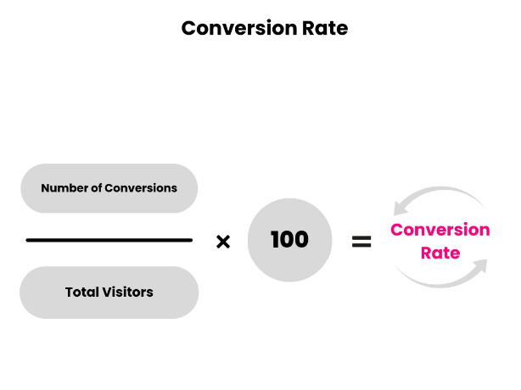
Predicting Click Conversion Rate
Abhijeet Sharma, Saranya Chintalapati, Keerthi Bai Reddy, Shuvrangshu Mukhopadhyay

Slide 2
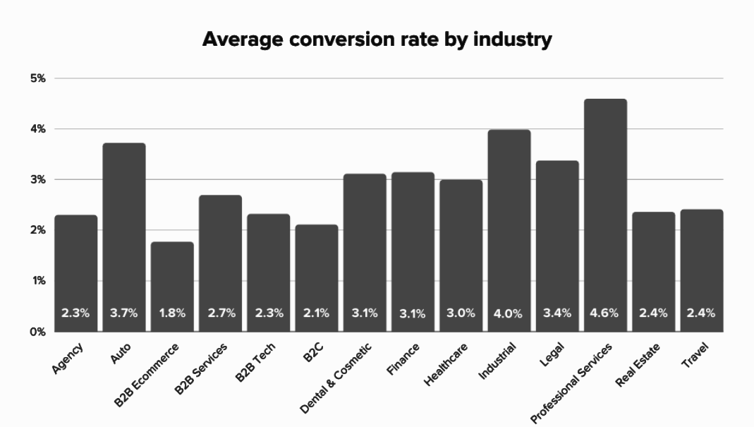
Problem Statement
Predicting Conversion Rates of Product on eCommerce Website:
Despite increasing traffic to an ecommerce website, the conversion rate with respect to product remains low.
The project aims to create a model that can determine the primary drivers of ecommerce conversion rates, enabling the optimization of product presentation for higher conversion rates.
2.9%
Average Conversion Rate

Slide 3
Source | Research Question | Predictors | Other Notes
SUCCESS FACTORS OF E-COMMERCE – DRIVERS OF THE CONVERSION RATE AND BASKET VALUE Darius Zumstein and Wolfgang Kotowski Zurich University of Applied Sciences, Institute of Marketing Management Theaterstrasse 17, 8400 Winterthur, Switzerland | What are the success factors of an ecommerce website in order to boost conversion rate and average basket value? | Independent Variables: Website design (including usability, appearance, and navigation) Product presentation (including quality of product images, product descriptions, and user reviews) Pricing strategy (including level of prices, promotions, and discounts) Customer service (including response times, availability, and helpfulness) Dependent Variables: Conversion rate (the percentage of website visitors who complete a purchase) Basket value (the average value of a customer's shopping cart) The study found that website design had the strongest impact on conversion rates, followed by pricing strategy and customer service. Product presentation had a smaller but still significant impact. The study found that sales channel (i.e. the platform or marketplace used to sell products) had a significant impact on conversion rates and basket values. Specifically, the authors found that using multiple sales channels (such as a company website and a third-party marketplace) was associated with higher conversion rates and basket values compared to using a single sales channel. The authors recommend that e-commerce businesses focus on improving their website design, product presentation, pricing strategy, and customer service in order to increase conversion rates and basket values. | Limitations of the study include a relatively small sample size (120 online shoppers) and the fact that the study was conducted in a specific geographic location (Switzerland). However, the authors note that managing multiple sales channels can be challenging, and that businesses should carefully consider the costs and benefits of using different sales channels before making any changes to their sales strategy.

Slide 4
Source | Research Question | Predictors | Other Notes
POST-CLICK CONVERSION RATE PREDICTIVE MODEL ON E-COMMERCE RECOMMENDER SYSTEM By Yuhe Ding A Master’s paper submitted to the faculty of the School of Information and Library Science of the University of North Carolina at Chapel Hillin partial fulfillment of the requirements for the degree of Master of Science in Information Science. Chapel Hill, North Carolina December 2018 | What is the influence of various product features on customers' decision-making process during online purchases after click behavior? | X variables used in the regression model include user demographics, past purchase history, and features of the recommended item. Y variable is click-through rate (CTR). Statistical tests used include linear regression, XGBoost algorithm, and random forest. Linear regression and random forest have similar mean squared error (MSE) of around 2% for CTR prediction, while gradient boosting has a slightly higher MSE of around 2.59%. All the 3 model’s most important features for CTR prediction is CTR during the past 7 days, followed by average position during the past 7 days and current average position. All three models have similar levels of prediction variability. | These variables can overlap with each other, which needs more attention Could potentially include data about device, time of the day This paper does not utilise user demographics as it states initially, might impact the model

Slide 5
Source | Research Question | Predictors | Other Notes
Predictive Analytics of E-Commerce Search Behaviour for Conversion Niu, X., Li, C., & Yu, X. (2019). Predictive analytics of e-commerce search behavior for conversion. Journal of Retailing and Consumer Services, 49, 224-233. doi: 10.1016/j.jretconser.2019.04.009 | How consumer behaviour functions for an ecommerce website such as Walmart.com and what parameters influence this behaviour? | Independent Variables QueryLength: number of words in a query • CurrentQueryPosition: the position of the current query in the current session. For example, the current query might be the second query issued by a searcher in the same session • NumQuery: total number of queries in the current session • ClickPosition: the rank of the current click in the result list • AvgClickPosition: the average rank of all the clicks in the result list under the current query • NumSearchResults: total number of search results returned by the current query • NumClickQuery: total number of clicks in the current query • NumClickSession: total number of clicks in the current session • ClickEntropyQuery: the click entropy for the current query • AvgClickEntropySession: the average click entropy in the current session • PageDwellTime: how much time spent on viewing an item page • SessionDwellTime: how much time spent on the whole search session • UserType: whether the customer was registered or not with Walmart.com • Device: the device the customer was using to access the website. It has three values: desktop, tablet, and phone • HourOfDay: the local hour of the day of accessing the website. It ranges from 0 to 23

Slide 6
Source | Research Question | Predictors | Other Notes
 |  | Dependent Variable Conversion Decision(Binary 0 (No) & 1 (Yes)) Random Forest: Used to predict customer buying behavior based on 15 predictor variables and 1 target binary variable Insensitive to interactions of indicators and distribution of indicators 'mtry' parameter was tuned to select number of variables randomly chosen at each split 10-folds cross-validation with 15 repetitions used to train and evaluate model Highest accuracy achieved (0.7008) when 'mtry' was set to 3, indicating that the model with 3 random variables selected at each split performed the best Logistic Regression: Used to predict customer buying behavior based on 15 predictor variables and 1 target variable Addressed potential correlation among predictors using VIF and LASSO methods Four variables with high multicollinearity were removed, leaving 11 variables for the final logistic regression model construction Selected variables included AvgClickPosition, NumQuery, NumClickSession, and SessionDwellTime Final Results Random Forest Has highest Accuracy of 76% in comparison to logistic regression which is used as base model with accuracy of 61% | Random Forest Specificity-0.73 Sensitivity-0.82 Logistic Regression Specificity-0.61 Sensitivity-0.60

Slide 7
Source | Research Question | Predictors | Other Notes
The determinants of conversion rates in SME e-commerce websites TY - JOUR AU - Di Fatta, Davide AU - Patton, Dean AU - Viglia, Giampaolo PY - 2018/03/01 SP - T1 - The determinants of conversion rates in SME e-commerce websites VL - 41 DO - 10.1016/j.jretconser.2017.12.008 JO - Journal of Retailing and Consumer Services ER - | How can small and medium sized enterprises (SMEs) improve their conversion rates when they lack the resources to invest in or maintain a website? When websites investments have resulted in low ROI? | Independent Variable Free Shipping( 0 No - 1 Yes)-It is necessary to include free shipping as a decisive factor in our model for purchase. Free Returns( 0 No - 1 Yes)-We must include the availability of free returns in our model as it is a crucial factor that customers consider before making a purchase. Discounts - The influence of discounts on conversion is significant, and we must include it in our original model. Season( 0 regular - 1 Sales) Seasonal fluctuations have a significant impact on sales, so it is essential to include it in our model. Speed of load (0-100) The customer's frustration with E-commerce sites with high loading time is not significant and not important to be included in our model, which is generalized and not specific to any category. Luxury websites (0 non-brand products ; 1 branded products)-Not Important in our model as our model is genrealized and not specific to any category Week (0 = Saturday & Sunday - 1 = weekdays, Monday to Friday It is crucial to include weekends as they have a higher conversion rate and even more traffic impressions. Dependent Variable Conversion Rate (%)

Slide 8
Source | Research Question | Predictors | Other Notes
 |  | OLS Regression OLS regression with step-wise procedure was used to analyze the impact of independent variables on conversion rates. To account for correlations among data from the same source, we clustered standard errors within six retailers with multiple observations over time. QCA QCA identifies causal conditions that lead to the outcome of interest. It's useful for our case because conversion factors differ between luxury and non-branded products. Multiple pathways or routes may be better than linear relationships to explore how different factors interact QCA Findings Group-A1 Coverage Set-f*D*S*h Raw Coverage-0.47 Unique Coverage-0.47 Solution Consistency-0.976 (Highest Coverage) 2)Group-A2 Coverage Set-f*D*L Raw Coverage-0.29 Unique Coverage-0.0.61 Solution Consistency-0.978 3)Group-B1 Coverage Set-F*d*S*L*H Raw Coverage-0.014 Unique Coverage-0.014 Solution Consistency-0.915 4) Group-B2 Coverage Set-F*s*L*H Raw Coverage-0.172 Unique Coverage-0.023 Solution Consistency-0.953 | Note: F = free shipping, D = discounts, S = season, L = speed of load, H = luxury products Lowercase letters denote an absent attribute, uppercase letters denote a present attribute Total coverage = 0.474, Solution Consistency = 0.949

Slide 9
Source | Research Questions | Predictors | Other Notes
Analyzing conversion rates in online hotel booking. The role of customer reviews, recommendations and rank order in search listings. Asunur Cezar and Hulisi Ögˇüt Department of Business Administration, TOBB University of Economics and Technology, Ankara, Turkey | What is the effect of three primary technologies (review rating, recommendation, and search listings) on the conversion of browsing customers into actual buyers? | Y- Conversion rate X – Price, Rank, Recommendation Number, Location rating, Service Rating, City. How the Independent Variables are obtained: Using factor analysis on Customer review ratings, they are categorized into factors namely service rating(performance of hotel) and location rating(average rating for hotel's location). Each hotel’s rank was collected from default search listings in 10-minute intervals and collected the number of recommendations in eight-hour intervals. Other variables include Price, star rating and no of rooms. | Findings: customers value location rating more than both star rating and service rating in their hotel booking decisions. Rank (0.18%) and recommendations (0.05%) have positive significance on click conversion rates. High numbers of recommendations mitigate the adverse impact of a low rank in search listings on conversion rate Logistic regression is used in this analysis Beta distribution is used because studies show that it provides good results for fractional data i.e., y variable is between 0 and 1. A more explanation on it can be included. factor analysis is performed on customer ratings to diminish large no of variables into a fewer no of factors. A more detailed methodology on factory analysis could be included. .

Slide 10
Paper | Research | Findings | Other Notes
Impact of different platform promotions on online sales and conversion rate: The role of business model and product line length. Authors: Tingting Tong, Jianjun Xu Xun Xu Nina Yan | Research Question: To assess the impact of different promotional strategies on sales and conversion rate for e-commerce platforms, using transaction data from JD.com in China, and to investigate the moderating effects of business model and product line length on this impact. | Dependent Variable: Conversion rate Sales Independent Variable: direct promotions, gift promotions price promotions, Product type (‘reseller’==1,’marketplace’==0) SKU, quantity promotion, Bundle promotion, Coupon promotion , Length (product line length), Weekend, Holiday, Brand . It is a three-level hierarchical promotion structure and evaluates the impact of different platform promotions on sales and conversion rate. Monetary promotions that includes direct and quantity promotions have a stronger impact on sales and conversions than all the other promotions. The three key characteristics of e-commerce platforms include the employment of digital information and technologies, collection and use of transaction data, and network effects among users in the online community. Platforms serve as a reseller that purchases products from suppliers and resells them to consumers, as an intermediary marketplace in which suppliers can list the products that they have to sell. The product line length may affect consumers' perceptions of the promotion and their consequent shopping behaviors. | The data is from JD.com, one of the largest online retailer in China. OLS Regression OLS regression model with interactions was used to analyze the impact of independent variables on conversion rates. Fixed effect estimation method has been used to estimate the coefficients in models. Feature engineering is performed on the types of promotion (Monetary, Standardized, direct, quantity, bundle, coupon and gift). Two level and three level Interactions has been performed on reseller with types of promotion and brand. average standard deviation of the promotion rate for each SKU during each day is 0.006, indicating the daily promotion received by different consumers is relatively stable. The correlations of independent variables in less than 0.50 indicating no multicollinearity issues.

Slide 11
Paper | Research | Findings | Other Notes
Analyzing Factors of Users Click Behavior on Ads Sitong Zhou College of Urban Transportation and Logistics, Shenzhen Technology University, Shenzhen 518118, China | Research Question: To investigate the impact of user characteristics on clicking behavior in e-commerce advertising, the timing of ad placement and its effect on click-through rates | Dependent Variable: Click through Rate (CTR) Independent Variable: Gender (Men==1, women =2) Age, Consumption Level (It describes the level of consumptions in the form of Low, medium and high indicating the customers response to marketing efforts) Shopping Depth (It is segregated in the form of new , general and regular) Occupation – student (Undergrad==1, non-graduate == 0) Brand Tendency Appropriate contents of advertisements have a great influence on clicking advertising behavior and this conclusion indicates the importance of personalization. Research in this paper indicates that the products name and products discount-level shown on web page impact CTR significantly and a multivariate testing method was proposed by one of the authors showed that a combined age and gender consistency has more significant CTR than inconsistency online advertisements. The methods show more detailed market research and from shopping depth perspective, holding more promotion activities to grasp customers and stimulate customers’ desire to browse and buy would be helpful in formulating and adjusting advertisements delivery strategies from users’ perspective. | The data is about advertisement and users’ profiles of Taobao. Logistic Regression: Click =α+β1Gender + β2Age + β3Consumption Level + β4Shopping Depth + β5Occupation + β6Brand Tendency On performing the model, it infers click scale between men and women is 0.94:1 that indicates women tend to click online ads, older age people tend to click on ads, in terms of consumption level , customers buying low and medium prices products tend to click ads online and customers are likely to click on non-branded products than branded.

Slide 12
Source | Research Question | Predictors | Other notes
An examination of antecedents of conversion rates of e-commerce retailers Naveen Gudigantala Pelin Bicen Eom Robert B. Pamplin | What is the theoretical and empirical association between purchase intention and conversion rate, website satisfaction and conversion rate, and purchase intention and conversion rate? How do purchase intention and website satisfaction affect actual purchase behavior as represented by e-commerce conversion rates? | Indicators affecting website satisfaction are discussed like Information quality, system quality and service quality. Additionally, response time, website ease-of-use, language customization, Website layouts and transaction capabilities such factors are shown to affect website satisfaction largely. Purchase intention score is measured used various factors like trust, perceived ease of use, perceived trust, usefulness of the website. Presentation flaws, poor style, incompleteness lowers purchase intent score which directly impacts conversions. The more time a visitor puts into a website, the more likely he will make a purchase. Though this is important it is not taken as a predictor for regression analysis. Finally, 4.2% weightage on purchase intent score and a 5.4% weightage on website satisfaction is obtained from the analysis. These are significant values which affect conversions. Y- Conversion rate X - Purchase Intention score, Website satisfaction score, Average monthly visits, average unique monthly visits, average ticket price | Data is collected from Foresee.com of 20,000 visitors across various retail websites. Methodology: Multiple regression analysis Since purchase intention and website satisfaction are correlated so they are separately analyzed Note: . How the purchase intention score is calculated is not mentioned in the paper.

Slide 13
Dataset – South East Asian E-commerce Website - (Shopee Data - 20k Observations) Probable Predictors:
Web Analytics:
Website design (usability, appearance and navigation)
Website Satisfaction (NPS score)
Website's rank in search listing
Finance
Past Purchase history
Pricing strategy(price level, discounts types)
Product presentation (quality of product, user description, product rating)
Advertisement:
Monetary promotions
Product business model (reseller or marketplace)
Product line length
Seasonality:
Season
Hour of Day
Free returns
Free shipping
User’s search behavior:
Avg Click Entropy Session
User type (registered user or now user)
Page Dwell Time
Impressions
Current Query Position
Num Query
Click Position
Num Search Results
Num Click Query
Num Click Session
Speed of load
Others:
Average monthly visits
Device (tablet, desktop, mobile)
Traffic source (web, mail, multi)
The prevailing research literature predominantly centers on customer behavior analysis aimed at comprehending the customer journey and its association with conversion. Our study introduces a distinctive viewpoint that concentrates on the impact of product-level attributes on click conversion rates.
Note that the predictors in this case might change, since majority of the predictors are proprietary and are not available publicly.

Slide 14
Data Source
Owner: Shopee Indonesia. An ecommerce giant South-East Asia.
Proprietary Data: Readily available on AWS marketplace for free for research purpose.
Variables: We have 4 levels of data, product level, category level, department level, & store level, brand level.
Product Level
ITEM_ID
ORIGINAL_PRICE
SALE_PRICE
REVIEW_RATING
REVIEW_COUNT
SOLD
VIEW_COUNT
HISTORICAL_SOLD
STOCK
LIKED_COUNT
SHOW_DISCOUNT
DISCOUNT_PERCENT
CREATE_TIME
PRODUCT_NAME
MONTH_YEAR
Store Level
SHOP_ID
SHOP_LOCATION
Brand Level
BRAND
Category Level
CATE_ID
CATEGORY
DEPARTMENT
Masked
Data
(Excluded)
Masked Data
(Excluded)
Category
is more granular, so will see its fixed effect

Slide 15
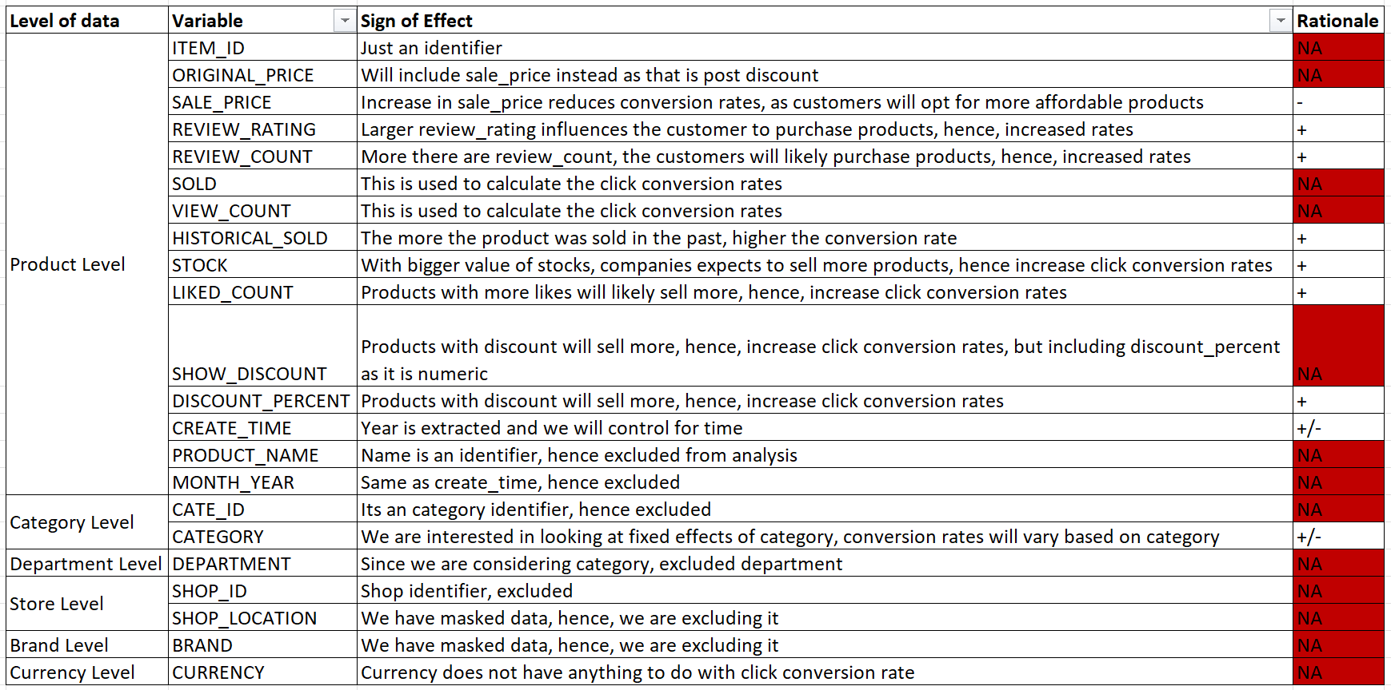
Predictor Table

Slide 16
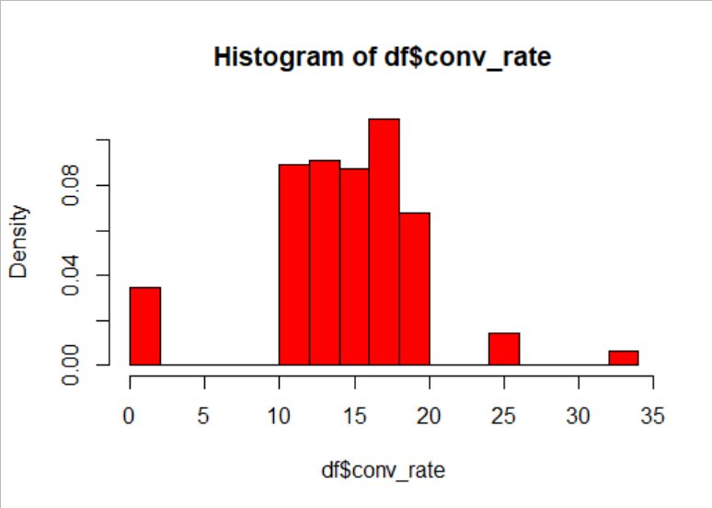
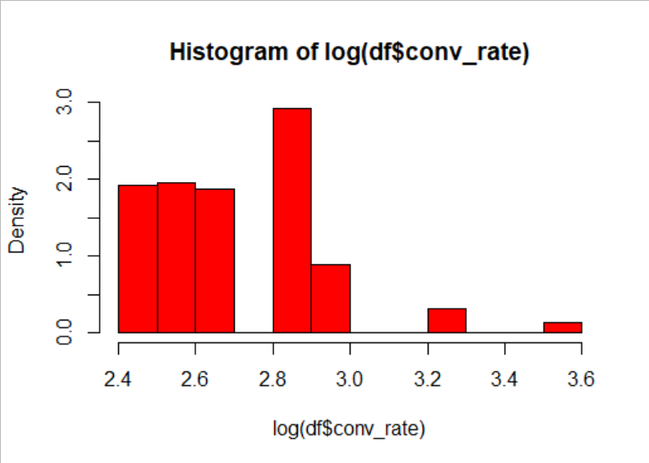
Exploratory Data Analysis
Distribution of Conversion Rate | Distribution of Log of Conversion Rate

Slide 17
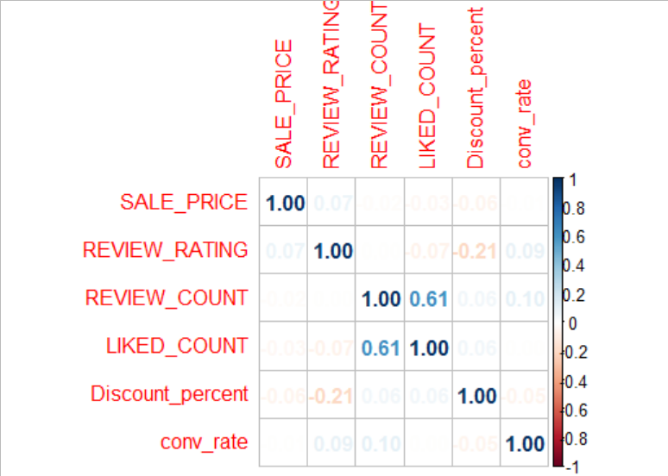
Correlation Plot
We do not see any evidence of correlation among the predictors

Slide 18
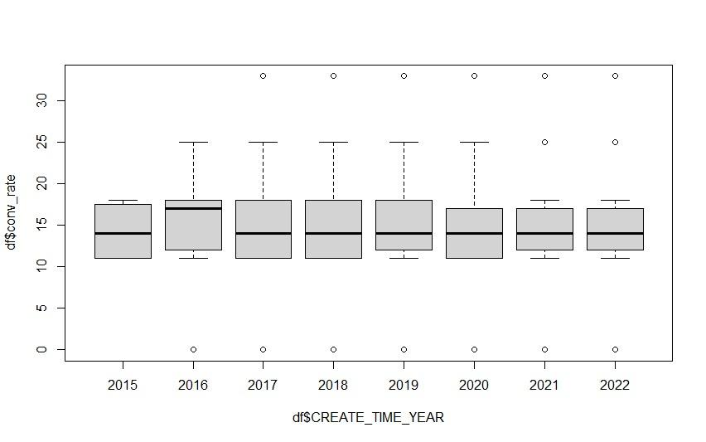
Distribution of Conversion rate over the years

Slide 19
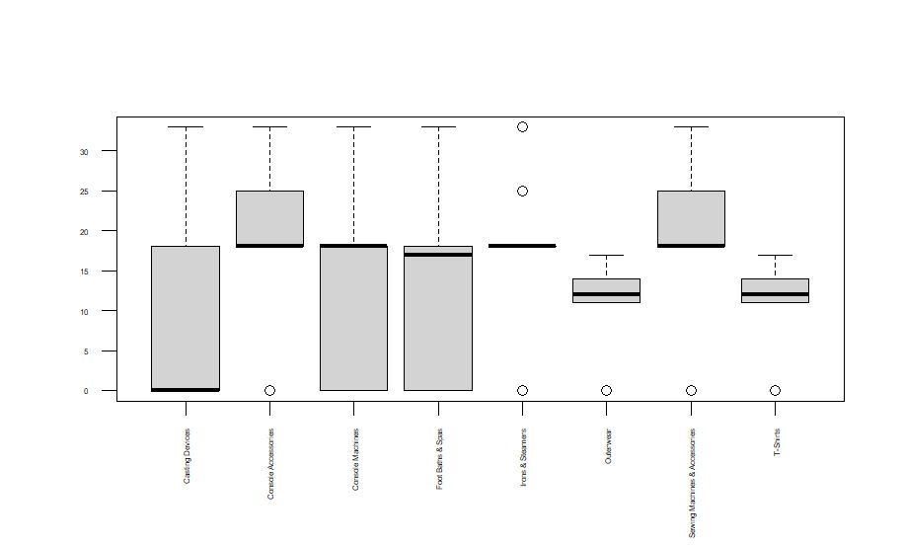
Distribution of Conversion rate by Category

Slide 20
Models
We are predicting click conversion rates which is essentially a ratio, hence, we cannot use GLM or LM models.
The dependent variable is censored and bounded between 0 and 100, hence, tobit model is the right choice
Baseline Model:
lm1 = lm(conv_rate~ SALE_PRICE + REVIEW_RATING + REVIEW_COUNT + HISTORICAL_SOLD + STOCK + LIKED_COUNT + Discount_percent + CATEGORY + CREATE_TIME_YEAR, data = df)
Tobit Model:
tobit1 = censReg(conv_rate~ SALE_PRICE + REVIEW_RATING + REVIEW_COUNT + HISTORICAL_SOLD + STOCK + LIKED_COUNT + Discount_percent + CATEGORY + CREATE_TIME_YEAR, left = 0, right = 100, data = df)
Tobit Model:
tobit2 = censReg(conv_rate~ CATEGORY*REVIEW_RATING + LIKED_COUNT + HISTORICAL_SOLD + STOCK*SALE_PRICE + discount_percent*CATEGORY + CREATE_TIME_YEAR, left = 0, right = 100, data = df)

Slide 21
Stargazer Output
==============================================================================================================
Dependent variable:
--------------------------------------------------------------------
conv_rate
OLS censored
regression
(1) (2) (3)
-----------------------------------------------------------------------------------------------------------------
SALE_PRICE -0.000 (0.000) -0.000 (Inf.000) -0.00000 (Inf.000)
REVIEW_RATING 0.103 (0.135) 0.103 (Inf.000) -0.634 (Inf.000)
REVIEW_COUNT 0.001*** (0.0001) 0.001 (Inf.000) 0.001 (Inf.000)
LIKED_COUNT -0.0001 (Inf.000)
HISTORICAL_SOLD -0.0001*** (0.00001) -0.0001 (Inf.000) -0.0001 (Inf.000)
STOCK -0.000 (0.00000) -0.000 (Inf.000) -0.00000 (Inf.000)
Discount_percent 1.125 (0.805) 1.193 (Inf.000) -11,721.950 (Inf.000)
CATEGORYConsole Accessories 12.579*** (0.398) 13.890 (Inf.000) 2.091 (Inf.000)
CATEGORYConsole Machines 5.859*** (0.397) 6.807 (Inf.000) -2.040 (Inf.000)
CATEGORYFoot Baths & Spas 2.688*** (0.633) 3.221 (Inf.000)
CATEGORYIrons & Steamers 10.332*** (0.401) 11.607 (Inf.000)
CATEGORYOuterwear 4.654*** (0.370) 5.829 (Inf.000) 2.229 (Inf.000)
CATEGORYSewing Machines & Accessories 13.565*** (0.401) 14.895 (Inf.000)
CATEGORYT-Shirts 5.871*** (0.369) 7.188 (Inf.000) 2.697 (Inf.000)
CREATE_TIME_YEAR2016 1.114 (2.293) 1.147 (Inf.000) 1.140 (Inf.000)
CREATE_TIME_YEAR2017 -0.660 (2.247) -0.814 (Inf.000) -0.669 (Inf.000)

Slide 22
CREATE_TIME_YEAR2018 0.156 (2.237) 0.097 (Inf.000) 0.153 (Inf.000)
CREATE_TIME_YEAR2019 0.821 (2.233) 0.784 (Inf.000) 0.812 (Inf.000)
CREATE_TIME_YEAR2020 0.621 (2.231) 0.579 (Inf.000) 0.617 (Inf.000)
CREATE_TIME_YEAR2021 1.050 (2.230) 1.051 (Inf.000) 1.037 (Inf.000)
CREATE_TIME_YEAR2022 0.756 (2.232) 0.725 (Inf.000) 0.736 (Inf.000)
CATEGORYConsole Accessories:REVIEW_RATING 2.171 (Inf.000)
CATEGORYConsole Machines:REVIEW_RATING 1.643 (Inf.000)
CATEGORYFoot Baths & Spas:REVIEW_RATING
CATEGORYIrons & Steamers:REVIEW_RATING
CATEGORYOuterwear:REVIEW_RATING 0.503 (Inf.000)
CATEGORYSewing Machines & Accessories:REVIEW_RATING
CATEGORYT-Shirts:REVIEW_RATING 0.671 (Inf.000)
REVIEW_COUNT:VIEW_COUNT -0.000 (Inf.000)
STOCK:SALE_PRICE 0.000 (Inf.000)
CATEGORYConsole Accessories:Discount_percent 11,947.390 (Inf.000)
CATEGORYConsole Machines:Discount_percent 12,998.620 (Inf.000)
CATEGORYFoot Baths & Spas:Discount_percent
CATEGORYIrons & Steamers:Discount_percent
CATEGORYOuterwear:Discount_percent 11,724.480 (Inf.000)
CATEGORYSewing Machines & Accessories:Discount_percent
CATEGORYT-Shirts:Discount_percent 11,722.410 (Inf.000)
logSigma 1.562 (Inf.000) 2.983 (Inf.000)
Constant 6.158*** (2.348) 4.837 (Inf.000) 9.670 (Inf.000)
-----------------------------------------------------------------------------------------------------------------
Observations 13,094 13,094 13,094
R2 0.283
Adjusted R2 0.282
Log Likelihood -37,727.360 -48,900.590
Akaike Inf. Crit. 75,500.730 97,881.190
Bayesian Inf. Crit. 75,672.760 98,180.380
Residual Std. Error 4.458 (df = 13072)
F Statistic 245.683*** (df = 21; 13072)
=================================================================================================================
Note: *p<0.1; **p<0.05; ***p<0.01

Slide 23
Model Interpretations
Significant Beta Coefficient:
Interaction terms Beta Coefficient:

Slide 24
Thank you!

